Slide 1
IMS
Nikolaos Paloukos

Slide 2
Introduction
What is ims?
What it does?
How its made?

Slide 3
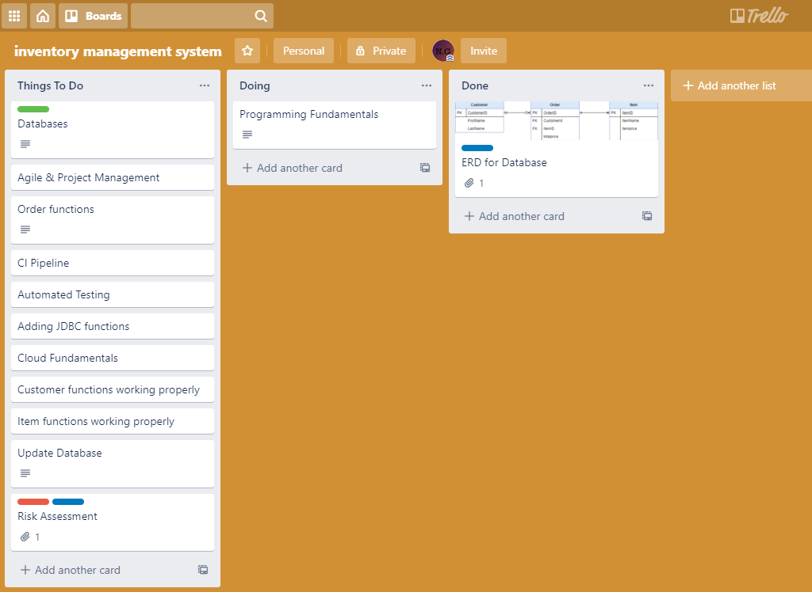
kanban board

Slide 4
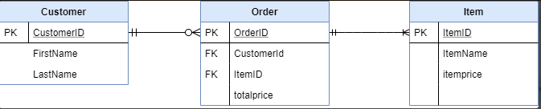
ERD diagram

Slide 5
Let's go back...
Git & Github
MySQL - GCP
IDE - for Java, jdbc, maven testing
CI pipeline - Jenkins
Sonarqube
Nexus
Mockito

Slide 6
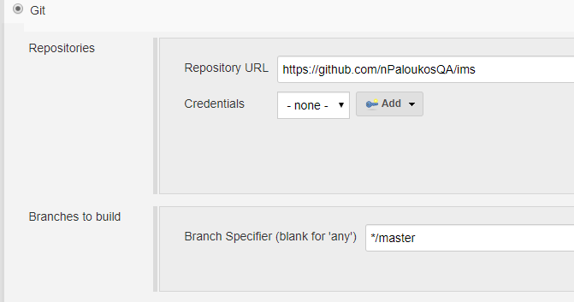
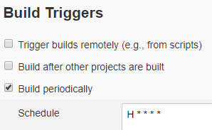
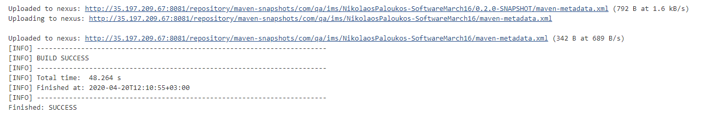
CI Pipeline

Slide 7
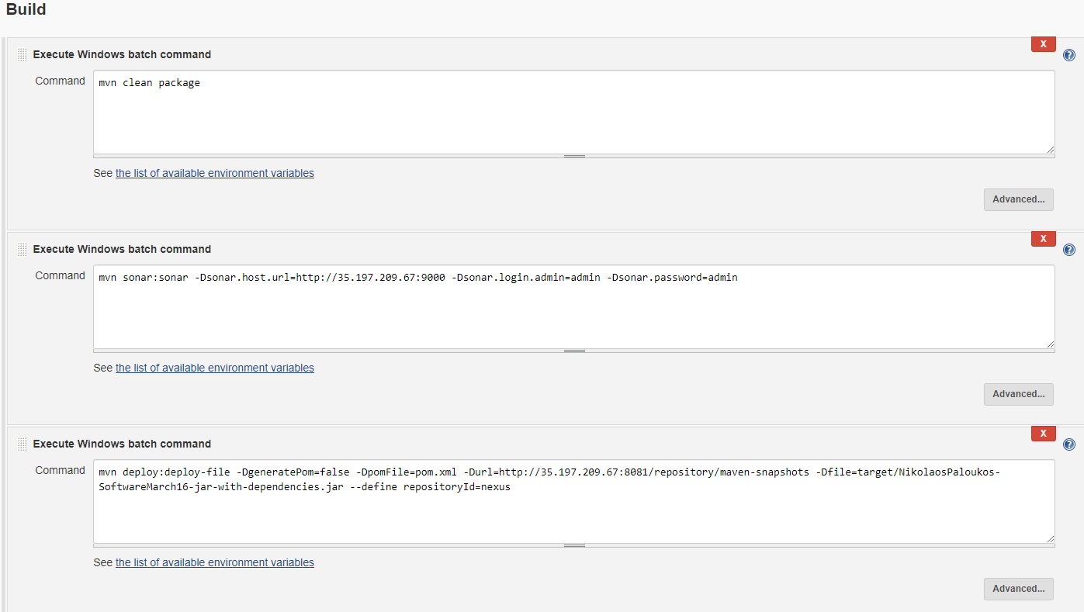
CI Pipeline

Slide 8
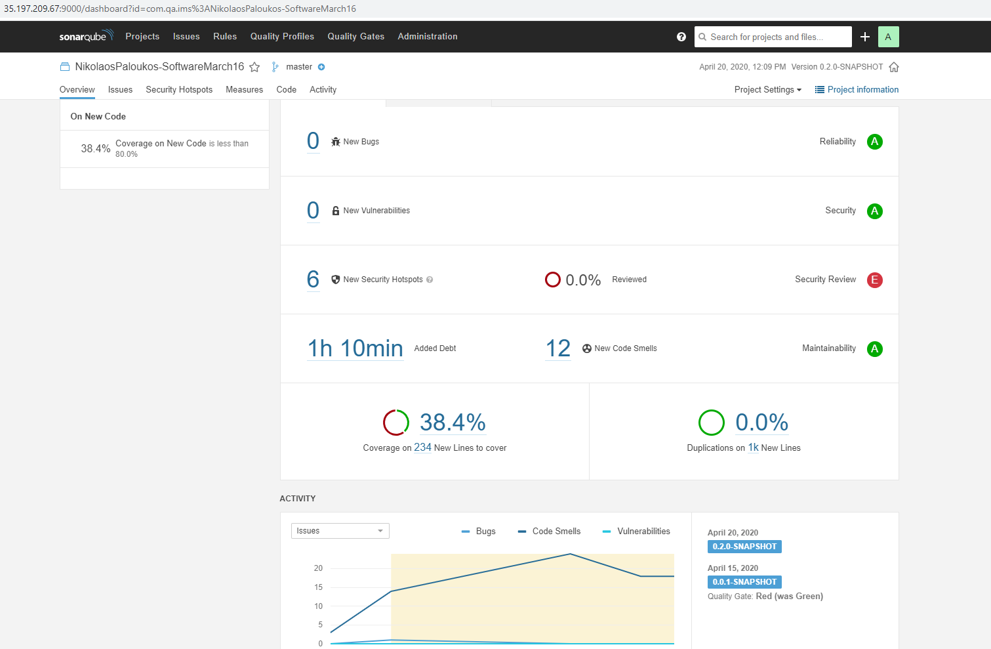
Sonarqube

Slide 9
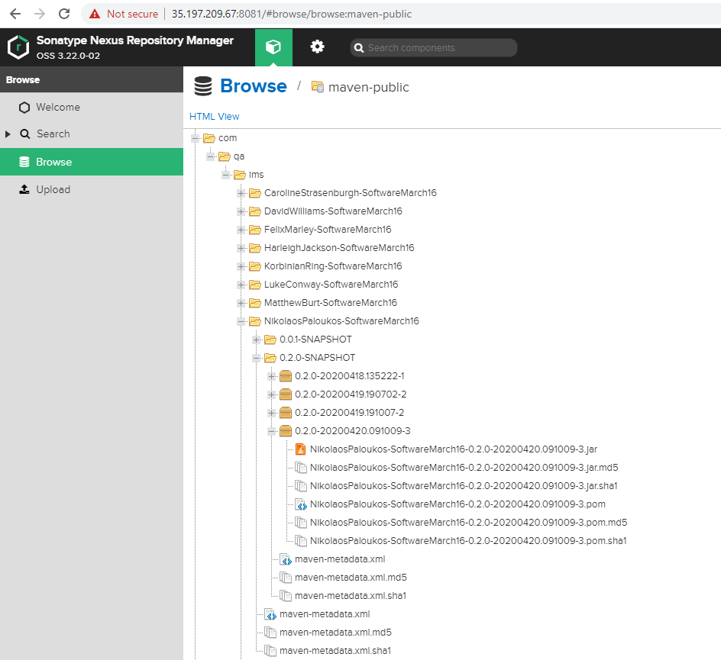
Nexus

Slide 10
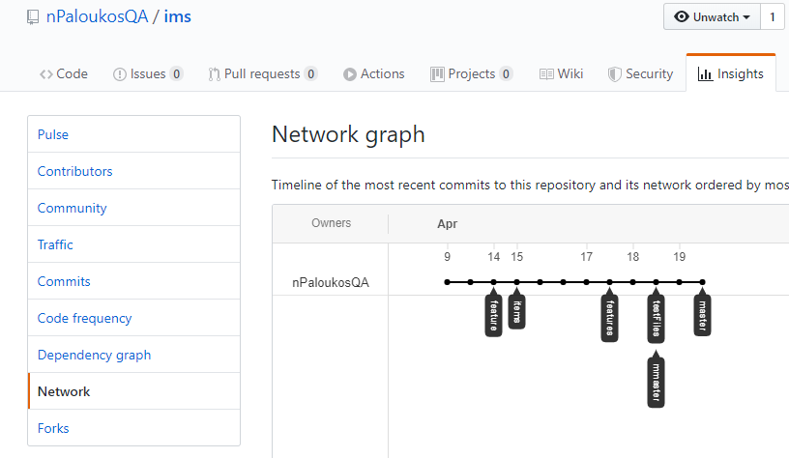
Git commits of project

Slide 11
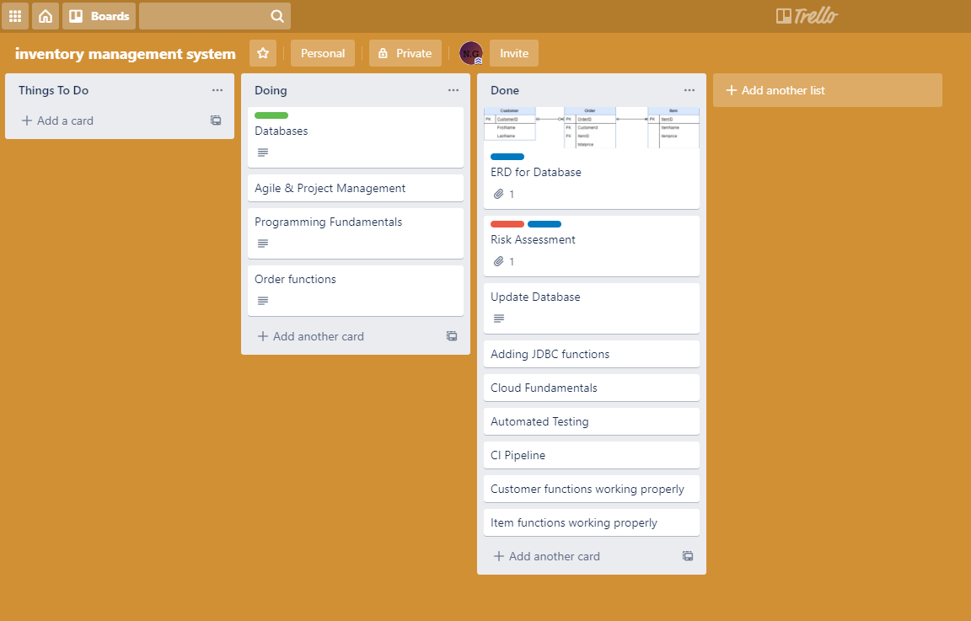
Sprint review

Slide 12
Conclusion
Improve unfinished topics
Adding more functionality

